Slide 1


Welcome
Times Tables Parent Information Session
Spring Term
2025
Mrs C Pettifer – Assistant Headteacher, Maths Lead, NCETM Teaching for Mastery Specialist, LLME (Local Leader of Mathematics Education)

Slide 2
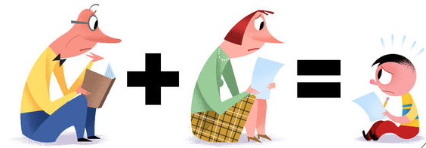
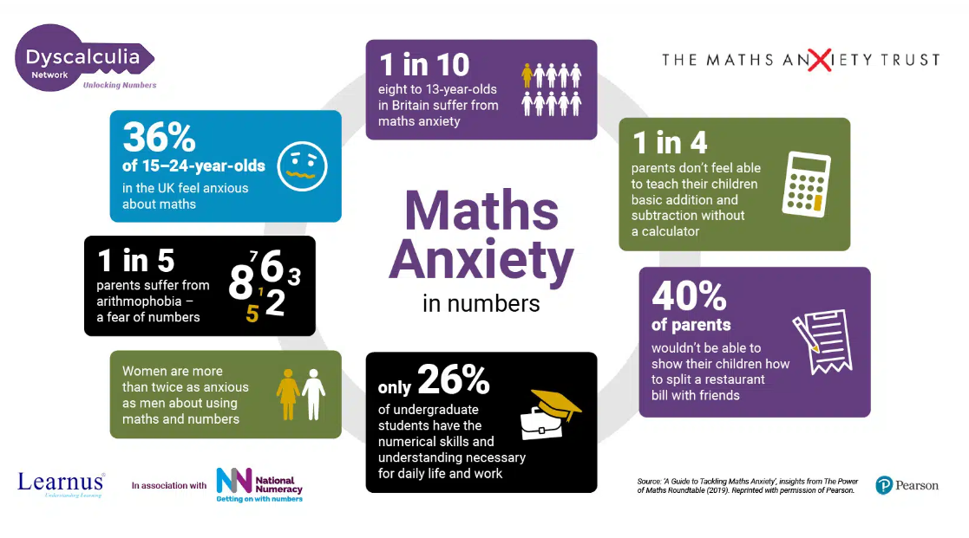
Before we start….

Slide 3
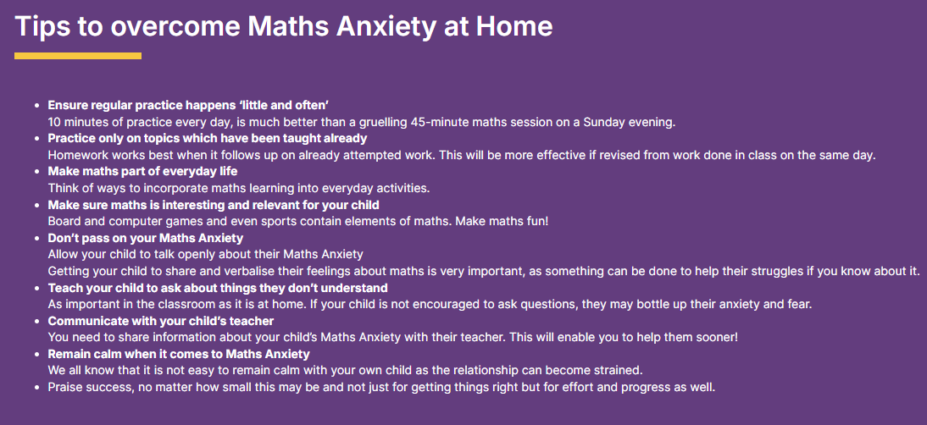

Slide 4
What correlation is there between scores on the MTC and KS2 SATS tests?
Pupils who scored 19 or above (out of 25) on the Year 4 MTC almost all achieved the expected standard in the KS2 SATS.
Of those who scored 13 or below on the MTC, almost none achieved the expected standard in the SATS.
Of those scoring between 14 and 18 marks on the MTC, about half of the pupils achieved the expected KS2 standard.
The mean score of those with full marks in the MTC was 110.
This might suggest that it is possible to predict at the end of Year 4 (with a reasonable degree of certainty) which pupils are likely to achieve the expected standard at the end of Year 6.
Mark Dawes, Cambridge Maths Hub, Multiplication Tables: from Year 4 to Year 7 December 2024

Slide 5
Children who are not fluent in their times tables by the end of Year 4 will struggle to access the Year 5 and Year 6 curriculum, making learning new skills and concepts far more difficult.
Professor Jenny Field: ‘the ability to retrieve some basic mathematical facts without effort, including times tables, decreases cognitive load’.
Here are some example questions from the KS2 SATs to illustrate this:

Slide 6
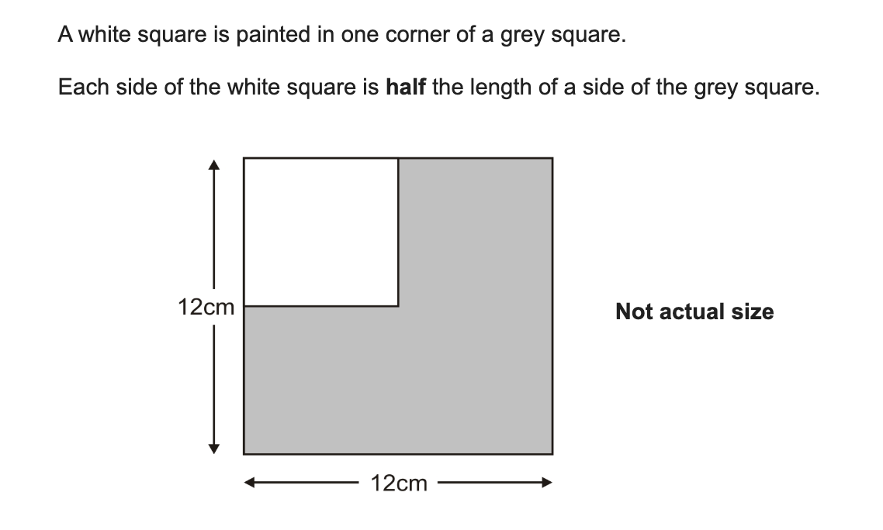
What is the area of the white square?

Slide 7
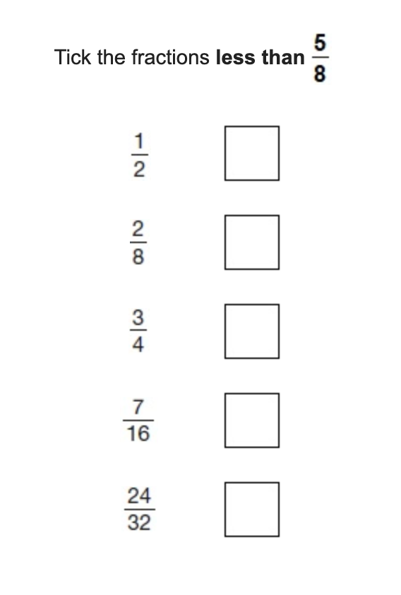

Slide 8
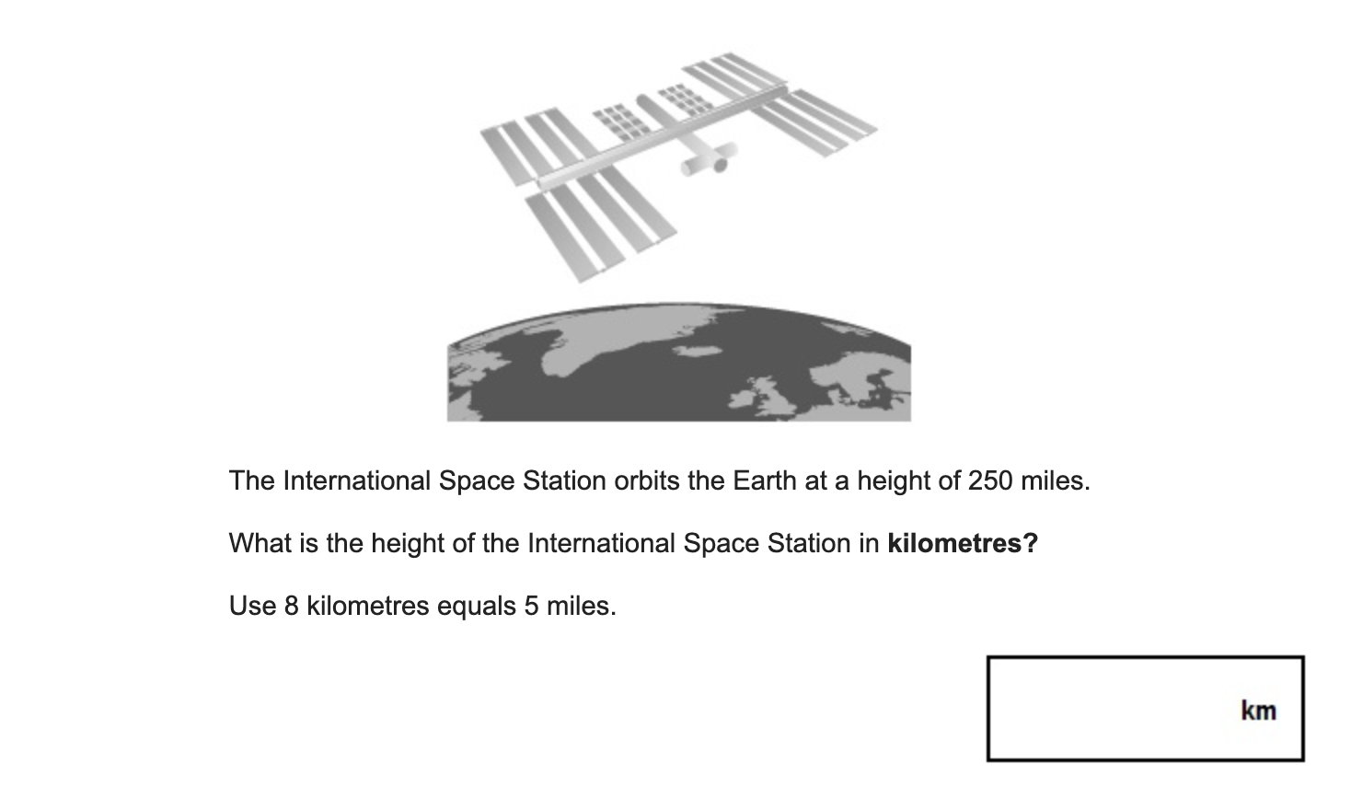

Slide 9
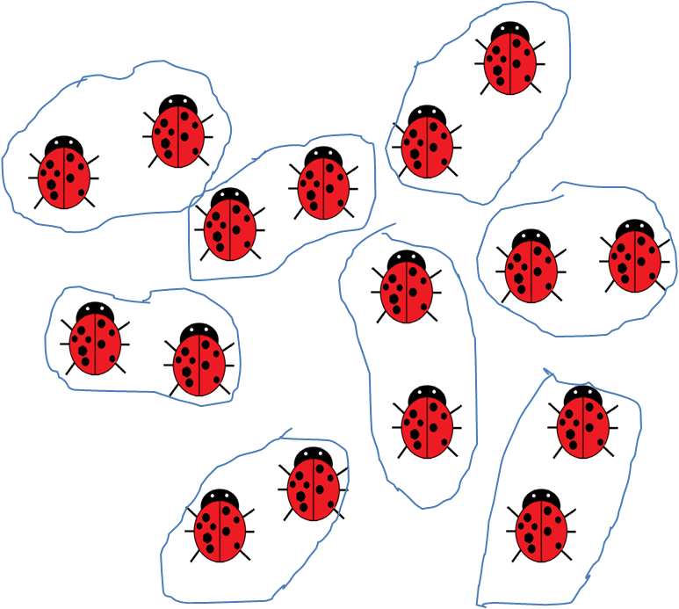
Times Tables are vital to the curriculum throughout school
Reception and Year 1
Some children may start grouping objects in twos
Some children may count on or back in fives and tens

Slide 10
Times Tables are vital to the curriculum throughout school
Year 2
Know and recall multiplication and division facts for 2,5 and 10s
2 x 5 = 10
5 x 2 = 10
10 ÷ 2 = 5
10 ÷ 5 = 2

Slide 11
Times Tables are vital to the curriculum throughout school
Year 3
Know and recall multiplication and division facts for 3, 4 and 8
3 x 5 = 15
5 x 3 = 15
15 ÷ 3 = 5
15 ÷ 5 = 3
24 x 3

Slide 12
Times Tables are vital to the curriculum throughout school
Year 4
Know and recall multiplication and division facts for 6, 7, 9, 11 and 12
3 x 12 = 36
12 x 3 = 36
36 ÷ 3 = 12
36 ÷ 12 = 3
274 x 7
673 ÷ 7
23 x 10 x 3

Slide 13
Times Tables are vital to the curriculum throughout school
Year 5
Children are expected to be fluent in their times tables up to 12x by the end of Year 4.
Know and recall squared and cubed numbers ( 3 x 3 , 3 x 3 x 3)
4,623 x 45
4724 ÷ 8
40 x 700
5 x 90
What is one twelfth of 36?
Equivalent fractions

Slide 14
Times Tables are vital to the curriculum throughout school
Year 6
Children are expected to be fluent in their times tables up to 12x by the end of Year 4.
3624 x 76
3624 ÷ 65
What is nine tenths of 70?
What is 60% of 300?
What is 71% of 1800?
Ratio

Slide 15
“Leaving primary school with a fundamental grasp of basic numeracy is as important as leaving being able to read. And just as the phonics check has helped more children learn to read, this will ensure more pupils know their times tables.”
Nick Gibb, Schools Minister

Slide 16
Year 4 Multiplication Tables Check (MTC)
‘By the end of year 4, pupils should have memorised their multiplication tables up to and including the 12 multiplication table and show precision and fluency in their work’.
National Curriculum 2014
The MTC is a new statutory KS2 assessment to be taken by pupils at the end of Year 4. This sits alongside the existing end of KS2 SATs assessments in Year 6.
The MTC is focused on the fluent recall of multiplication facts ( 4 x 9 ).
The MTC will be delivered as an online, on-screen digital assessment and should take less than 5 minutes to complete. This will be taken in school on either a desktop computer or a tablet.
The MTC will happen between within a two-week window starting on Monday 2nd June. As RPS has an additional half term week, the check will be happening the week beginning Monday 9th June.

Slide 17
What will the assessment look like?
The assessment will take place in June.
The children will be expected to answer 25 multiplication questions based on all tables up to 12x.
The children will be expected to do this in 6 seconds or less, meaning that quick recall of tables rather than working them out is essential.
The test will be scored automatically and will be marked out of 25. Data will be reported back to schools, parents and pupils as a score out of 25.
Children will only be considered to be fluent in their times tables if they achieve full marks in the assessment.

Slide 18
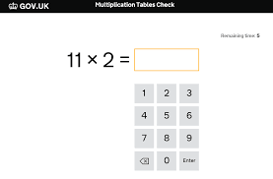
An example...

Slide 19
Access Arrangements
Access arrangements can be made for children who:
-have an Education, Health and Care (EHC) plan
- have an ASI (additional SEND support)
- have English as an additional language and have limited fluency in English
The timer can be hidden and a break can be given between each question, but the timing remains at 6 seconds for all children regardless.

Slide 20
What if my child does not achieve full marks in the MTC?
The MTC will serve as a measure of how well children understand and can recall their times table knowledge.
Times tables are vital to the Year 5 and Year 6 curriculum and gaps in their knowledge will hold them back when completing work in Years 5 and 6.
The MTC will serve as a helpful tool for teachers and schools in identifying children with gaps in their mathematical knowledge.

Slide 21
What are we doing to prepare children in school?
Times tables are taught as part of your child's maths lessons This includes teaching the tables as well as fluency work to apply this learning and improve speed of recall.
All children have access to a Times Table Rockstars account. This is an excellent online game where children are encouraged to practice their tables in a competitive way against peers, themselves or other members of the school.
Your child can work on their times tables awards.

Slide 22
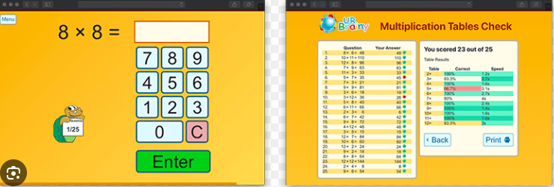
How can you help at home?
Method of learning | Useful links
Online games | Times Tables Rockstars: https://play.ttrockstars.com Hit the Button: https://www.topmarks.co.uk/maths-games/hit-the-button White Rose App - 2x 5x 10x Times tables - ‘beat Siri’
Paper based activities/games | How Close to 100? https://www.youcubed.org/tasks/how-close-to-100/ Pepperoni pizzas https://www.youcubed.org/tasks/pepperoni-pizza/ Flash cards with a difference https://www.youcubed.org/tasks/math-cards/ Speed grids Make cards to stick around the house
Mock test resource for practice at home | https://urbrainy.com/mtc/test

Slide 23
How can you help at home?
Method of learning | Useful links
Songs | Super movers: https://www.bbc.co.uk/teach/supermovers/times-table-collection/z4vv6v4 Times tables cover songs: https://youtube.com/c/laughalongandlearn
Books and other resources | Times tables Fables - a story to help ‘tricky’ tables facts to stick. Times tables stick - a way to help children to retain their times tables, and derive them from facts they know. https://www.youtube.com/watch?v=ljS0x6QwiJE

Slide 24
And finally...
Any questions? Please email the school office if I can help further.
Thank you for your time and support - it will really help your child!
Further reading if you’re interested and have the time:
https://home.oxfordowl.co.uk/maths/primary-multiplication-division/help-with-times-tables/

