Slide 1


Essex Outdoors, Bradwell
An exciting opportunity for your child

Slide 2

Why We Run the Year 6 Residential Trip
Develop independence and resilience
Build teamwork and friendships
Experience outdoor learning and adventure
Create lasting memories

Slide 3
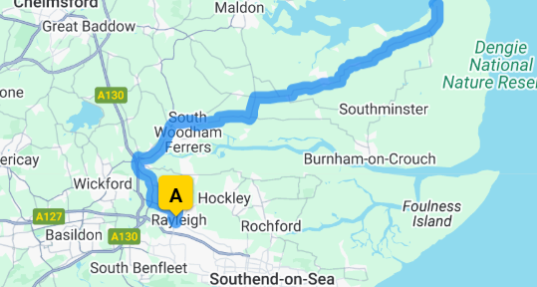
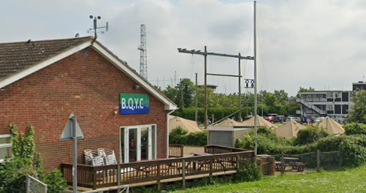
Essex Outdoors, Bradwell
13th – 17th July 2026
Away for 4 nights
Essex Outdoors promotional video
Notes:
"The trip will take place at Essex Outdoors, which is located in Bradwell On Sea, Southminister. It is a well-established residential centre that we have used before, known for its excellent facilities and experienced staff. The trip is scheduled from 13th to 17th July 2026, meaning we will be away for 4 nights.“
Bradwell is a Royal Yacht Association (RYA) Training Centre and a leading provider of sailing, yachting and water sport activities for schools, groups, businesses and individuals on the East Coast of England.

Slide 4
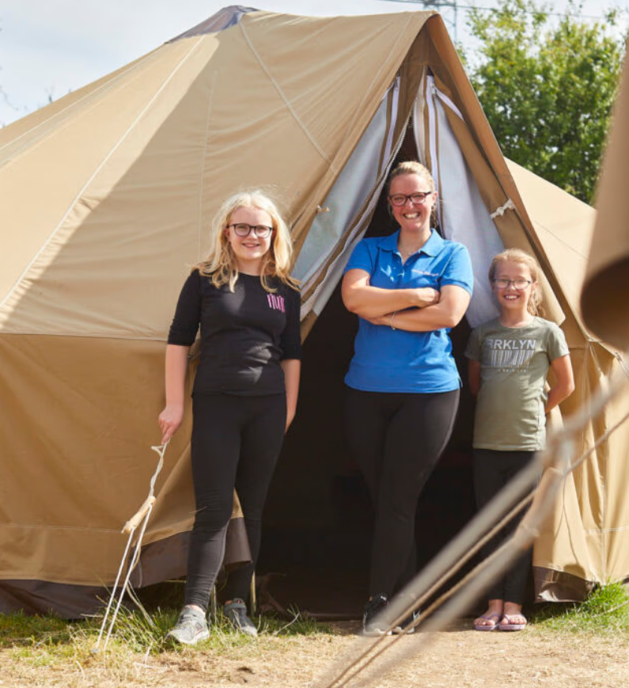
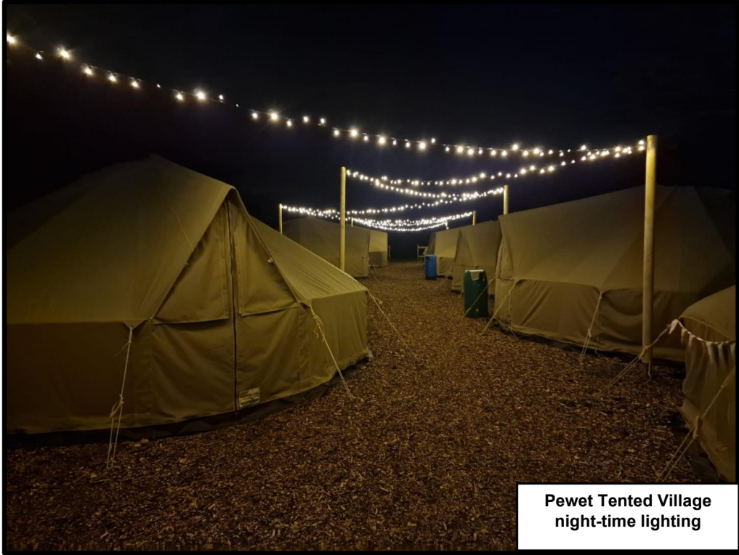
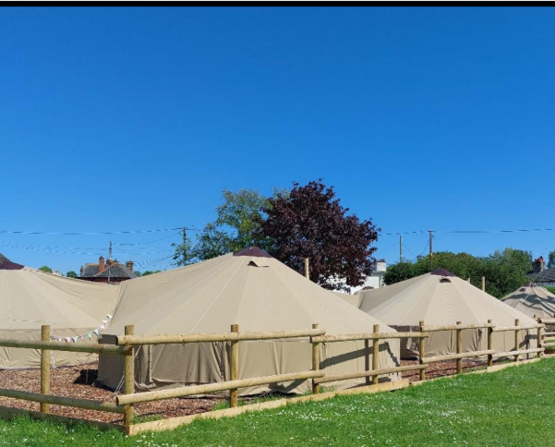
Accommodation & Catering
13th – 17th July 2026
Away for 4 nights
Notes:
Accommodation:
The tented village offers Nomadic Bell tents each with lighting, mattresses and ground sheet. The village also includes a multi purpose marquee with lighting, fridge, tea/coffee/drinks making facilities and games i.e. table tennis, table football.
Please note, bedding is not provided and therefore all visiting students and staff will need to bring a sleeping bag and pillow for their stay.
Catering:
Catering covers 3 meals per 24 hour stay. An additional lunch on your day of arrival and departure day has also been included.
Meals are provided onsite by the catering team. We provide a group information form to be completed and returned to us before a visit commences, this will include details of any dietary requirements to ensure we can accommodate them during a visit.
Catering can be provided form the main dining room or in a large marquee.

Slide 5
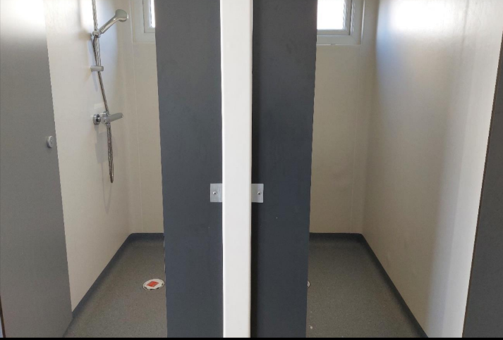
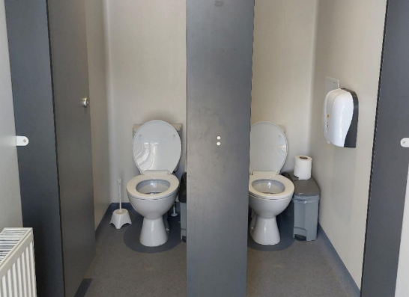
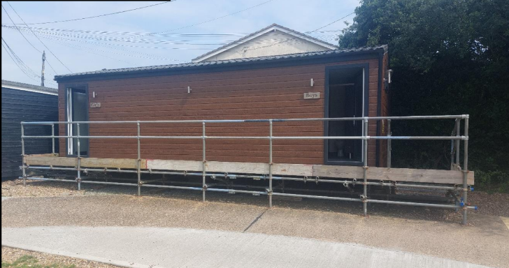
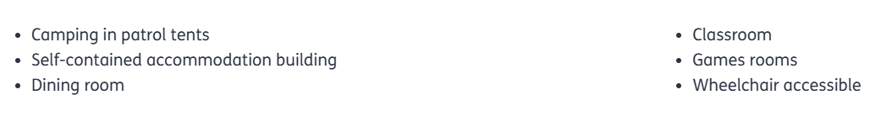
Toilet and shower facilities are provided within the main residential building and via a separate block on site.

Slide 6

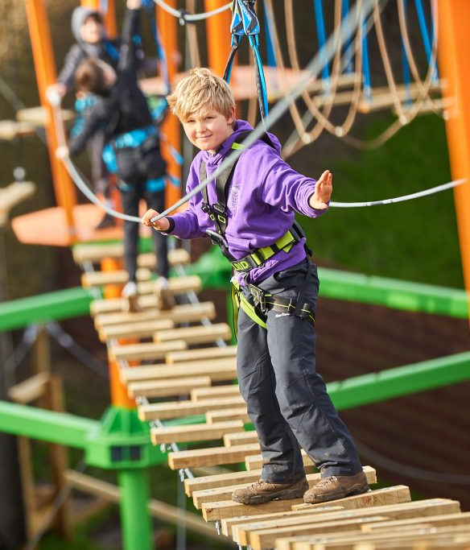
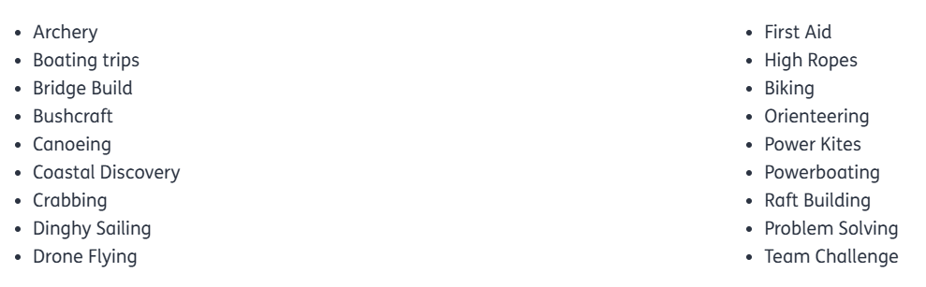
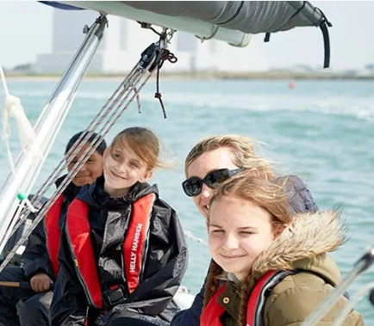
Activities
Notes:
The trip is designed to be fun and challenging, with a wide range of activities. Each activity is designed to promote teamwork, problem-solving, and resilience. Our experience shows that even children who are initially nervous end up loving the activities and feeling a great sense of achievement.

Slide 7
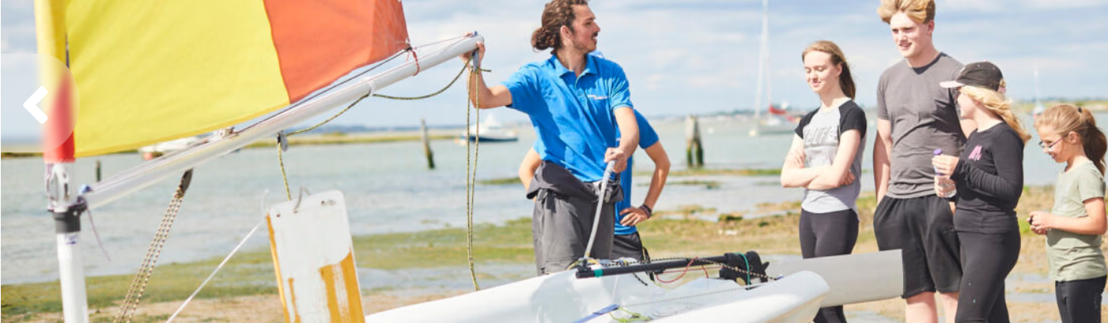
Safety and Supervision
Fully trained staff with enhanced DBS checks
24/7 supervision from school staff and venue staff
Emergency procedures in place
First-aid trained staff on site
Notes:
We take safety very seriously. The centre’s staff are fully trained, and all activities are run with safety equipment and qualified instructors. School staff will be on duty at all times, and we follow strict supervision procedures, including regular headcounts and a designated first-aider available 24/7. In the unlikely event of an emergency, we have clear protocols in place and will contact parents as needed.
Can be assured that all of the activities, although adventurous, are also educational, safe and delivered by competent staff. In line with our Codes of Practice, all of the activities offered by Essex Outdoors are delivered by staff that have been trained in accordance with both Essex County Council and national governing body (NGB) guidelines.
All staff who work with young or vulnerable people are subject to enhanced Disclosure and Barring Service (DBS) checks before employment with us.
Centre is inspected and approved by the Adventurous Activities Licensing Authority (AALA) and hold the Learning outside the classroom (LOtC) Quality Badge, ensuring they maintain the highest standards of safety and delivery in the industry.

Slide 8
Cost and payment
The total cost of the visit is approximately £455 (to be advised nearer the time) and includes: fully catered accommodation at Pewet tented village, residential catering (breakfast, lunch and evening meal), all instruction and activities, equipment and safety equipment.
To confirm a place for your child, please pay an initial deposit of £50 via our online payment system, Schoolmoney, before Friday 28th March 2025 in order to secure the booking.
Notes:
We offer a payment plan to spread the cost, and if any families are facing financial difficulties, please speak to us confidentially—we may be able to offer support or discuss alternative arrangements."

Slide 9
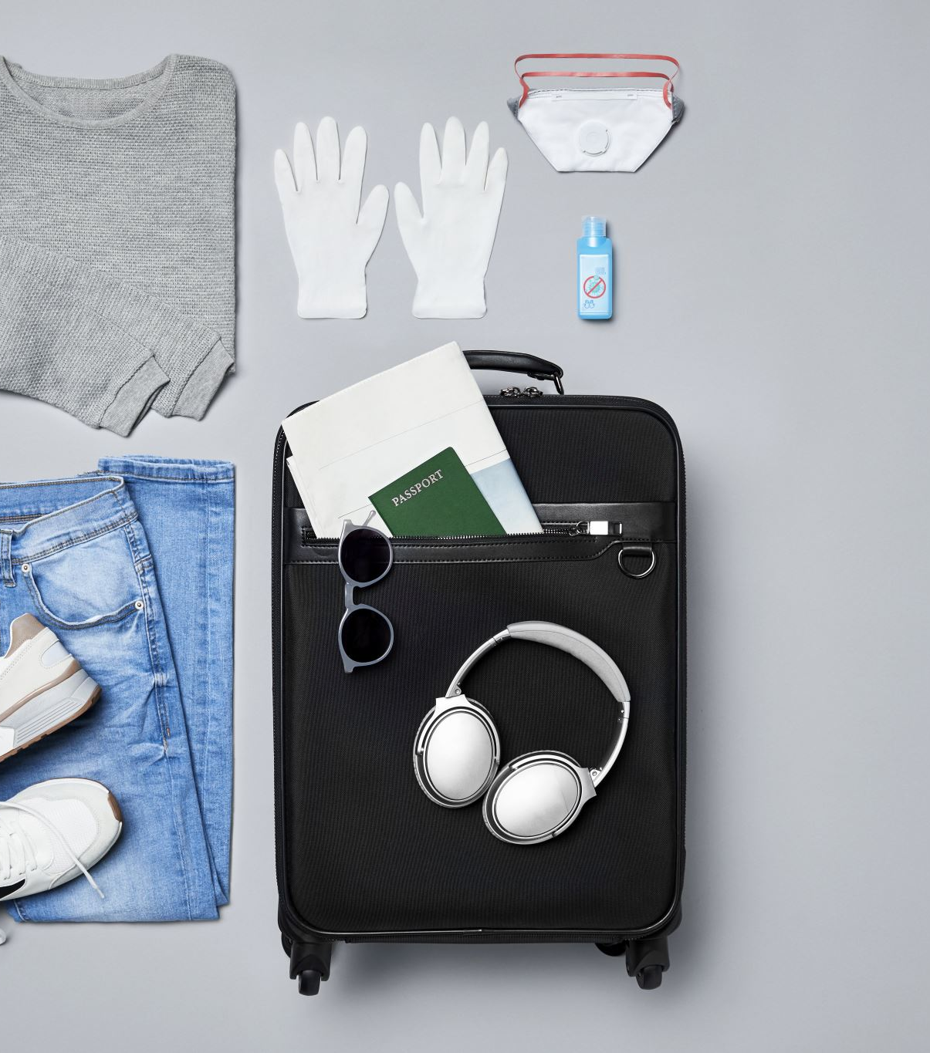
Packing and what to expect
Essentials (clothing, toiletries, waterproofs, footwear)
Items not to bring (e.g., mobile phones, valuables)
Reminder about labelling belongings
Link for Bradwell Kit List
Notes:
Please label all items with your child’s name. We ask that children do not bring mobile phones or valuables, as we want them to fully engage with the experience without distractions."

Slide 10

Next steps and key dates
Deposit deadline – before Friday 28th March
Final payment date – March 2026
Medical forms – early 2026
Pre-trip meeting date – early 2026
Contact the school office for any questions

Slide 11

Any questions?

